Slide 1
How I did start
Sultan Bassam
Junior full stack developer in my way ☺

Slide 2
Ask Ai tools
First I asked “Chat-GPT” about the way and guide me in this project and I give it all requirements needs

Slide 3
Digital sketch
1. Digital Sketch (Wireframe)
You need to start with a wireframe, which is a simple layout showing where each section will go. Use a tool like Miro, Figma, or even Paint to create a clear wireframe. Here's how to structure it:
Navigation Bar: Place this at the top. Include your logo on the left and links like "About," "Projects," "Skills," and "Contact" on the right.
Hero Section: This will be a full-width section below the navigation bar. Add a title and subtitle in the center, with an image background that doesn’t overpower the text.
Services Section: A 2-3 column layout showing what services you offer (e.g., web development, UI/UX design).
Skills Section: Use icons or bars to represent your skills in technologies like HTML, CSS, JavaScript, etc.

Slide 4
Cont’d
Projects Section: Display past work, each project in a card with an image and a brief description.
Testimonials Section: Showcase 2-3 client or colleague quotes.
Highlight Section: Use your creativity to emphasize your unique strengths here. Could be a carousel of projects, a video introduction, or awards.
Footer: Place contact details, social media links, and an optional form for people to message you.

Slide 5
Mockup
The mockup is a more detailed version of the wireframe. It will help you visualize the final design, including colors, fonts, and exact element placements. You can use tools like Figma or Adobe XD for this. The mockup should match your wireframe closely but with real text, images, and proper styles. Here’s what to focus on:
Color Scheme: Keep it simple and professional, maybe 2-3 colors. A light background with a darker color for text often works well.
Typography: Choose two fonts—one for headings and one for body text. Use tools like Google Fonts for this.
Layout: Make sure the design is well-aligned, with clear space between sections (padding/margins).
Responsiveness: Make sure the layout looks good on both desktop and mobile. You can show this in your mockup by creating a mobile version of the layout.

Slide 6
HTML 5 & CSS3
3. HTML5 & CSS3 Website
Now comes the coding part, where you'll turn the mockup into an actual website.
HTML5: Set up your basic structure using semantic tags like <header>, <section>, <footer>, etc.
CSS3:
Use Flexbox or CSS Grid to align items (for the responsive layout).
Set media queries to adjust the design on different screen sizes (for responsiveness).

Slide 7
Key Considerations
Responsiveness: Test the site at different resolutions (desktop, tablet, mobile). You can use Chrome DevTools for this.
Functional Links: Ensure all the buttons and links work. Avoid any dead links.
GitHub Repository: Once your project is done, upload it to GitHub and make sure the README file includes a brief description of the project and how to run it.

Slide 8
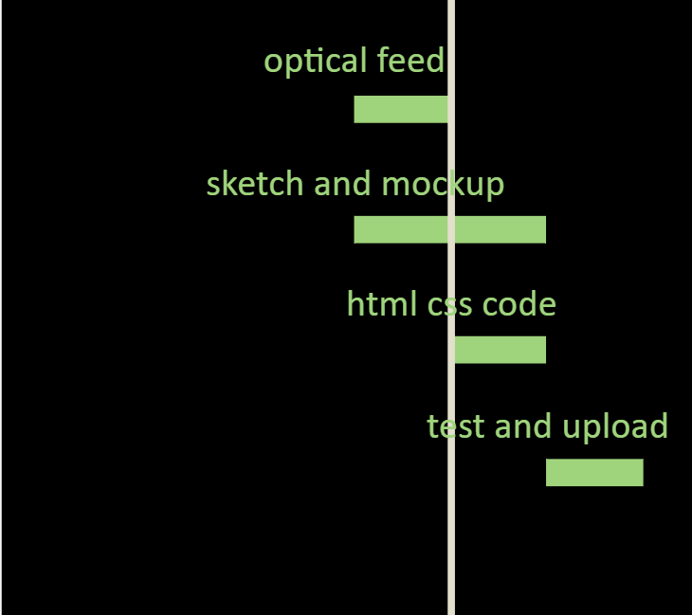
Timeline “GANT-CHART”

Slide 9
REFRENCES
MIRO
FIGMA
VSCODE
CHAT-GPT
AWWWARDS.COM
W3 SCHOOL
OVERFLOW-STACK
ONLINE GANT CHART

Slide 10
THANKS

